Slide 1
The role of phonation in the perception of the (incompletely) neutralized Polish word-final voicing contrast
Geoff Schwartz, Maral Asiaee, Kamil Kaźmierski & Ewelina Wojtkowiak
Adam Mickiewicz University in Poznań

Slide 2
Outline
Background
Voicing in Polish, and final voicing neutralization
Our production study of final devoicing in Polish
A perception study based on the production study
PCR analysis: effect of acoustic parameters (incl. voice quality) of our perception stimuli on accuracy
Discussion: linguistic vs. non-linguistic uses of phonation

Slide 3
Two-way voicing systems and final devoicing
Majority of the world’s languages: two series of obstruents usually described as voiceless (e.g. /ptk/) and voiced (e.g. /bdg/)
Polish dam ‘I’ll give’ vs. tam ‘there’
In many languages, the contrast described as neutralized in word-final position
Polish kod ‘code’ and kot ‘cat’ both pronounced as [kɔt]
The /d/ in kod said to undergo a rule of final devoicing which eliminates the contrast
does final devoicing really make kod and kot sound identical?

Slide 4
Does final devoicing neutralize contrast?
Many experimental studies:
German, Russian, Polish, Catalan
Small differences observed in parameters such as preceding vowel duration and closure duration – Incomplete Neutralization (IN)
Methodological challenges → skepticism of the results
Orthography
Polish speakers know that kod ends in the letter <d> which is likely to affect the way they produce the item in experimental settings
Roettger et al. (2014): challenge overcome, IN found in German
Schwartz, Kaźmierski, Wojtkowiak (2021) used a similar method for Polish

Slide 5
Schwartz et al. 2021
Schwartz et al., 2021: production study of final devoicing using nonce words and and a purely auditory singular formation task
participant hears: szeby/szepy występują w Warszawie
participant says: A w Poznaniu jest tylko jeden [szeb/szep]
15 monolingual speakers of Polish; 23 pairs of words
Acoustic measures of vowel duration and closure duration
Results
Vowels more or less the same duration before devoiced and voiceless consonants
Stop closures slightly longer (8.5 ms) in voiceless than devoiced consonants
Evidence for a slight IN effect in closure duration

Slide 6
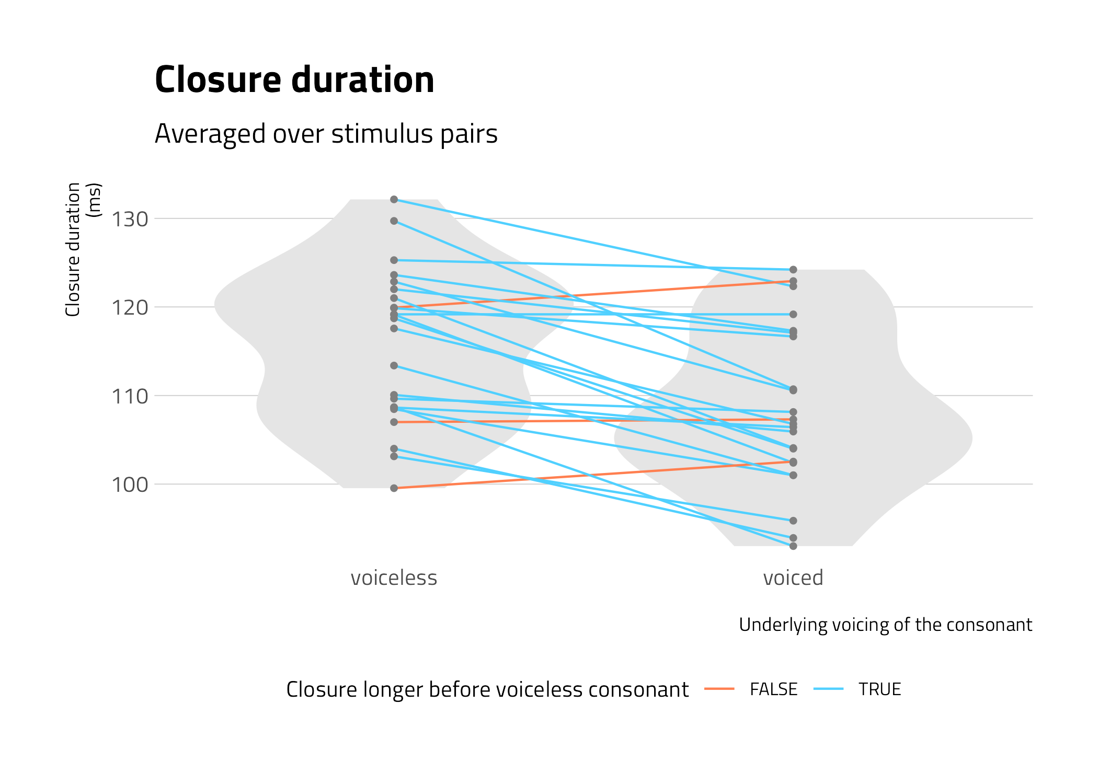

Slide 7
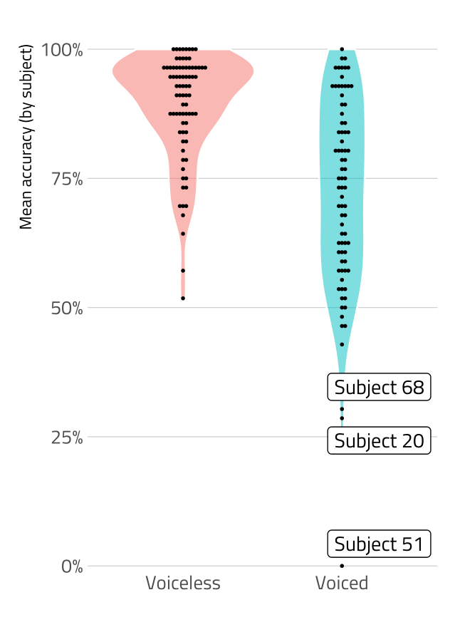
Perception of IN in Polish
Follow-up perception test [E-Prime]
79 L1 Polish listeners
Perception test using stimuli from production study
Listener hears: szeb or szep
Listener chooses between two plurals: szeby/szepy
Stimuli with normalized vowel and closure durations
80% accuracy rate !!!
89% accuracy for underlying voiceless, 72% for underlying voiced

Slide 8
Perception of IN in Polish
Surprisingly high accuracy rate in our perception test
Other studies: only slightly better than chance accuracy
Vowel and closure duration normalized in our stimuli → what other acoustic information listeners might be attending to?
Perhaps voice quality, which has been shown to play a role in voice contrasts . . .

Slide 9
The present study
Results of VoiceSauce analysis of our perception stimuli, along with an analysis of additional acoustic parameters other than vowel and closure duration
We use Principal Components Regression in an attempt to identify which acoustic information contributed to the high perceptual accuracy rate

Slide 10
Methods – statistical analysis
First, the acoustic differences between voiced-voiceless pairs in the stimuli calculated
Then, a Principal Components Regression (PCR) performed to identify which acoustic parameters were responsible for listener accuracy
A significant interaction found between Component 3 and underlying voicing

Slide 11
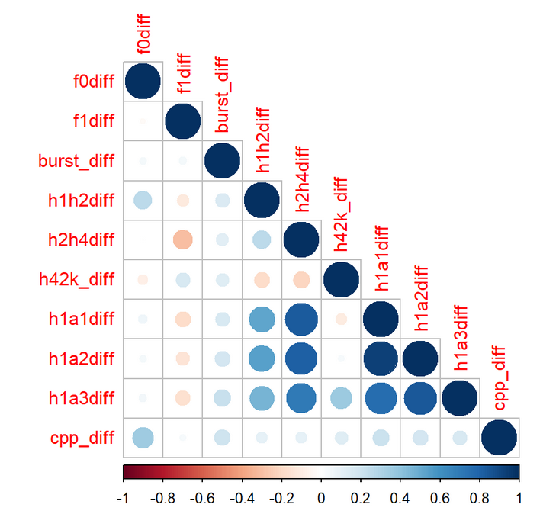
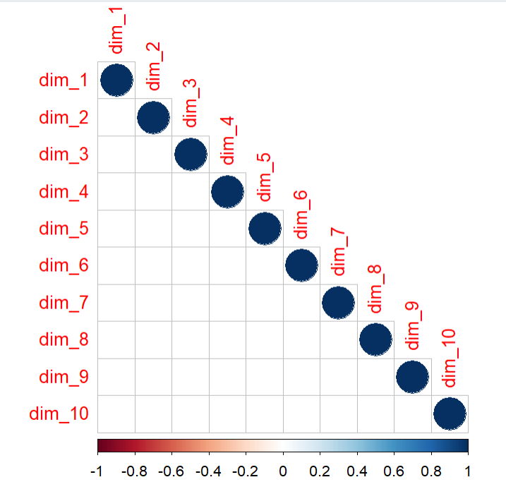
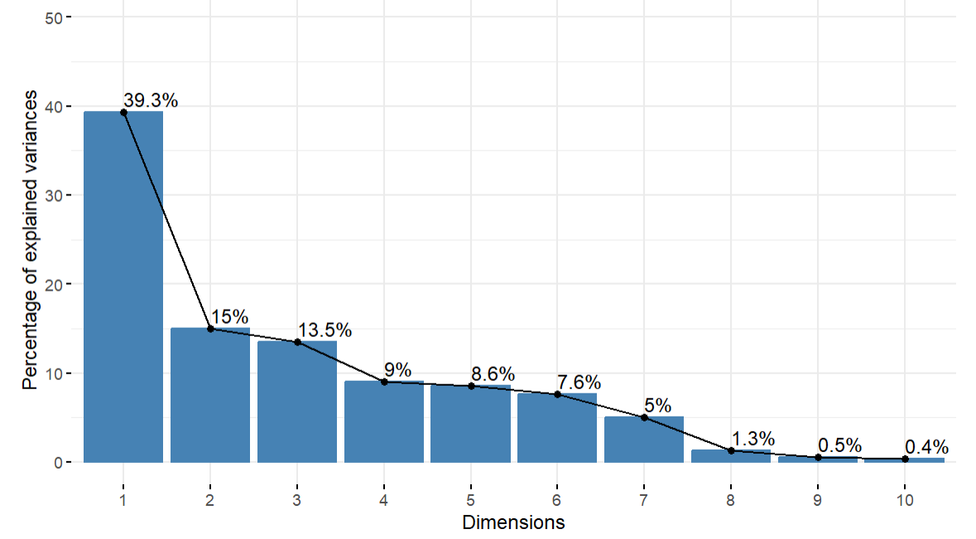
Principle Component Regression
k correlated variables
PCA: k uncorrelated components
Subset of components as regression predictors

Slide 12
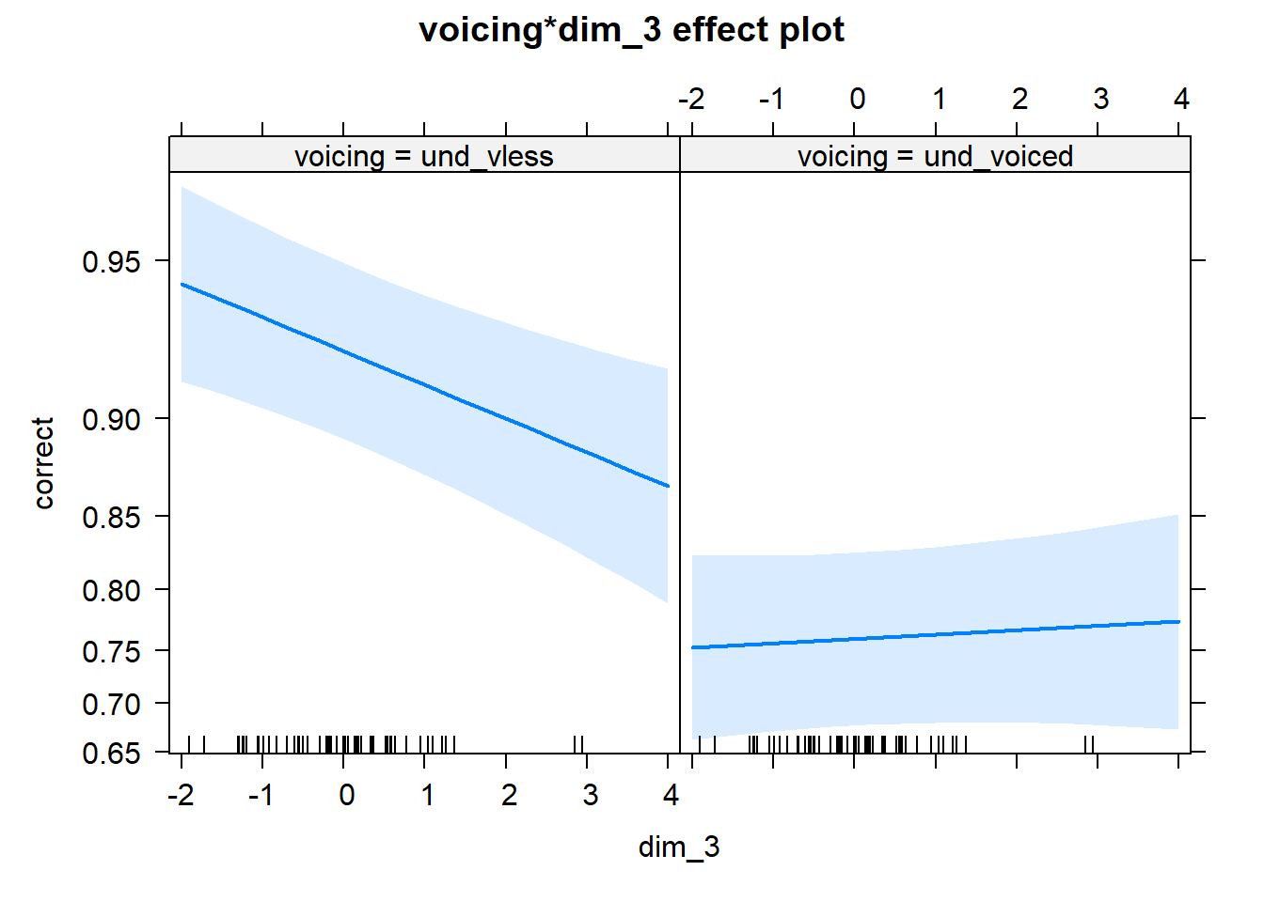
Results
Dimension 3, and its interacation with underlying voicing significant

Slide 13
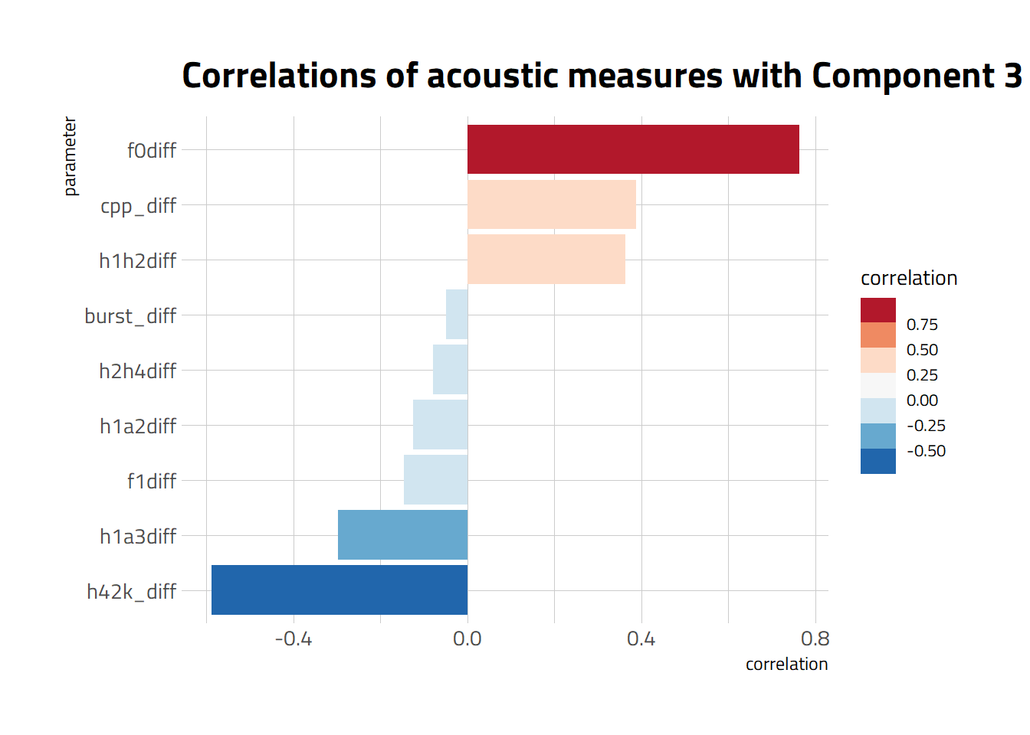
Results
measures in blue: improved accuracy;
measures in red: hindered accuracy
Note: Component 3 had a negative estimate in the regression model, so measures that are positively correlated with it decrease discrimination accuracy.

Slide 14
Results – summary of PCA analysis
f0 (pitch) and two voice quality measures (CPP; H1*-H2*) did not enhance accuracy
Four voice quality measures (H2*-H4*, H4*-H2K*, H1*-A2, H1*-A3) as well as burst duration and F1 did enhance accuracy
H4*-H2K* had the largest effect, followed by H1*-A3 (A3: harmonic nearest the third formant)

Slide 15
Discussion
Our result: acoustic elements of phonation do indeed play a role in the phonetic realization of the voicing contrast in Polish
Role of phonation already documented for voicing contrasts in English
glottal reinforcement/replacement of voiceless consonants
Sanker 2019, 2021: breathier voice quality linked to percept of longer vowels before voiced as opposed to voiceless consonants
This raises a more fundamental question about the relationship bewteen linguistic (i.e. phonological contrast) and non-linguistic (e.g. speaker identification) roles of voice quality

Slide 16
Discussion
The different effects for different measures of voice quality raise the following possibilities
Perhaps some measures are more reflective of linguistic properties (e.g. stress, voicing contrasts), while others play a greater role for speaker identification
Perhaps some measures are more important in a particular language for both linguistic and non-linguistic aspects, while others are less important
Our preliminary studies of Polish suggest that H4*-H2K* appears to play an important role for the voice contrast . . .
Notably, 2Khz is in the auditorily sensitive frequency range for loudness

Slide 17
Thank you for listening ☺
Email us for references:
geoff@amu.edu.pl, marasi@amu.edu.pl, kamil.kazmierski@amu.edu.pl, ewelina.wojtkowiak@amu.edu.pl

Slide 18
Extras

Slide 19
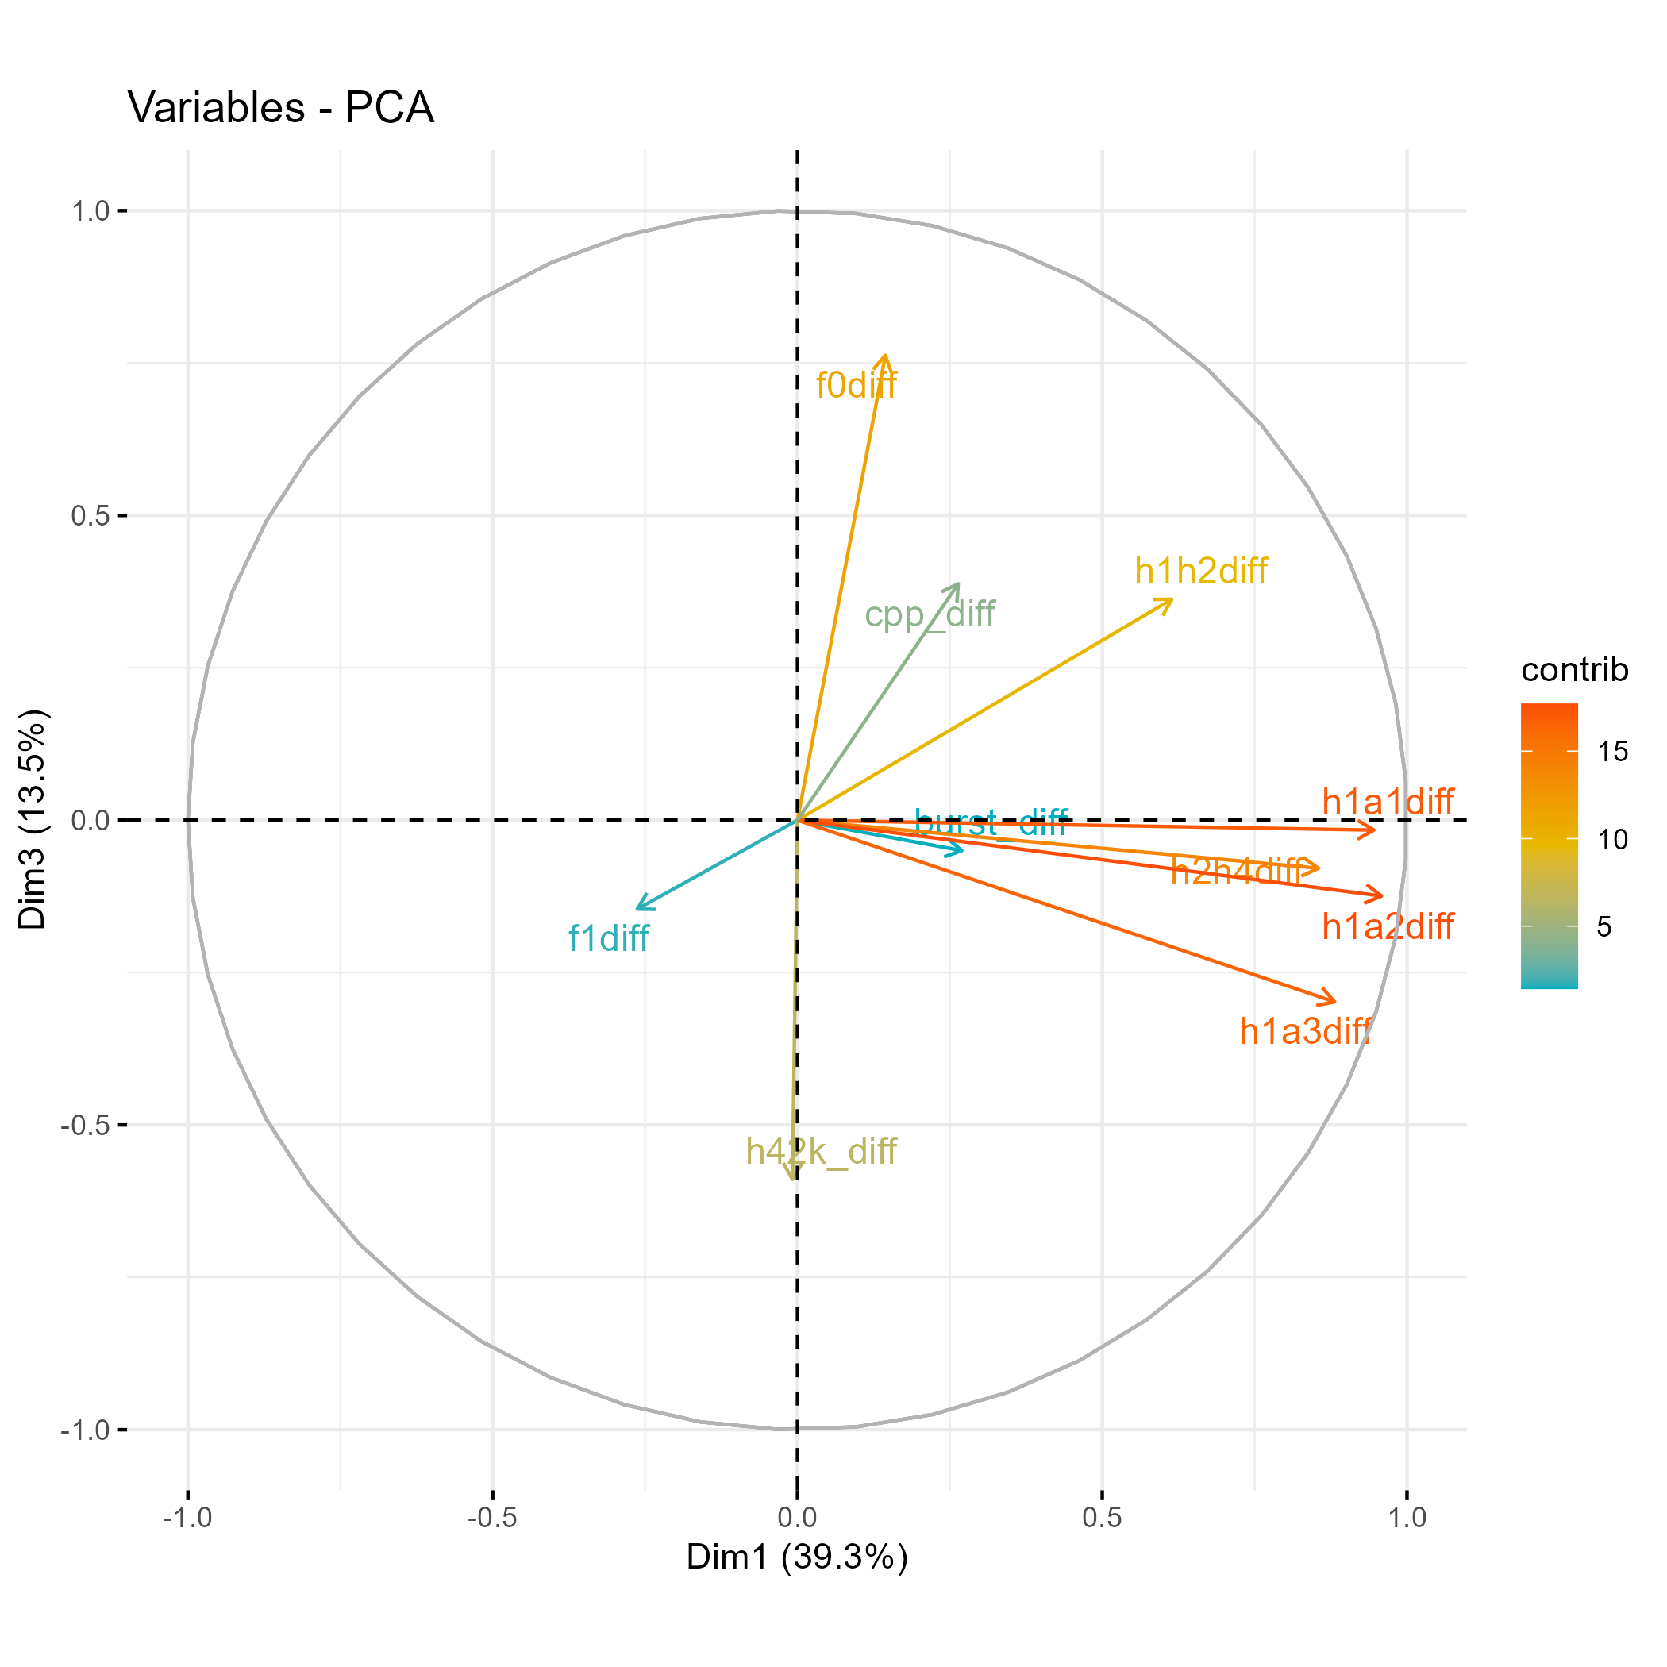

Slide 20
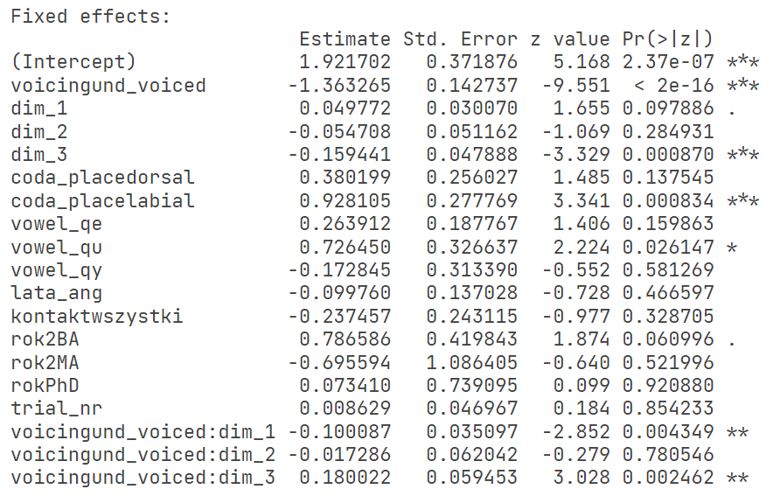

Slide 21
