Slide 1
Investigating predictors of foreign accentedness in L3 acquisition
Magdalena Wrembel, Kamil Kaźmierski, Katarzyna Dziubalska-Kołaczyk, Jarosław Weckwerth, Zuzanna Cal
magdala@amu.edu.pl
ICPhS Prague 2023

Slide 2
Introduction
Ratings of perceived global foreign accent
  widely applied in SLA research (Flege1988; Piske et al. 2001)
  but less frequently in TLA (but see Wrembel 2015).
L3 rating studies focus mostly on heritage speakers (Lloyd-Smith et al. 2017; Lloyd-Smith 2021).
Factors contributing to a perception of accentedness:
  amount of L1 use,
  AoA in the L2 country,
  non-native segmental features in the speech samples.

Slide 3
Theoretical framework
Natural Growth Theory of Acquisition (NGTA) (Dziubalska-Kołaczyk & Wrembel 2022) is holistic; both linguistic and extralinguistic factors account for the process of multilingual acquisition.
Main assumptions: gradual dynamic emergence of Ln phonology; shaped by input from the L1 and other Ls; influenced by typology, universal preferences, context.
NGTA relies on principled explanations as well as inductive, data-driven accounts.
NGTA is grounded in Natural Phonology (e.g. Donegan & Stampe 2009; Dziubalska-Kołaczyk 2012) and enhanced by Complexity Theory (Kretzschmar 2015).

Slide 4
Aims
To contribute to research on L3 phonetics and phonology.
To explore how a perceived global accent in L3 is correlated with the general proficiency level, oral fluency and fine-grained phonetic performance.
To apply the hierarchy of variables as proposed by NGTA.

Slide 5
Study
Part of a larger project investigating multilingual acquisition in L1 Polish – L2 English – L3 Norwegian learners
  Cross-linguistic influence in multilingualism across domains: Phonology and syntax
Longitudinal design (T1, T2, T3)

Slide 6
Study design: participants
Speakers (N=24)
  L1 Polish, L2 English, L3 Norwegian
  aged 21
  8 weeks of initial exposure to the L3 in a formal setting
Raters (N=30)
  18 Norwegian native speakers
  12 highly proficient L2 speakers of Norwegian
  some phonetic training
  moderate to considerable previous experience with foreign-accented speech in Norwegian

Slide 7
Measures
Profile: Language History Questionnaire (Li et al. 2006)
L3 Proficiency: Norwegian placement test
Amount/frequency of L3 use: a composite score based on self-declared answers in LHQ
Oral reading fluency: number of words per minute (wpm)
Fine-grained phonetic performance: VOT durations in /p, t, k/ in word list reading in L3
Rating parameters (on a 9-point scale):
  degree of foreign accentedness
  comprehensibility

Slide 8
Study design: speech samples
Excerpts from The North Wind and the Sun
Read in L3 Norwegian
48 words long
30 speech samples
  24 L3 learners
  6 Norwegian controls
  presented to the raters in a randomized order

Slide 9
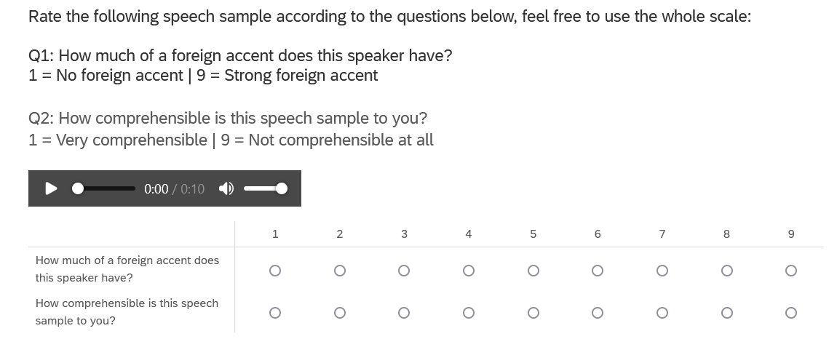
Online rating survey in Qualtrics

Slide 10
Research questions
RQ1: Do the rating parameters (accentedness and comprehensibility) correlate with one another?
RQ2: Does perceived global accent correlate with the learners’ proficiency level, oral fluency and fine-grained phonetic performance in the L3?
RQ3: Does perceived comprehensibility correlate with the learners’ proficiency level, oral fluency and fine-grained phonetic performance in L3 Norwegian?

Slide 11
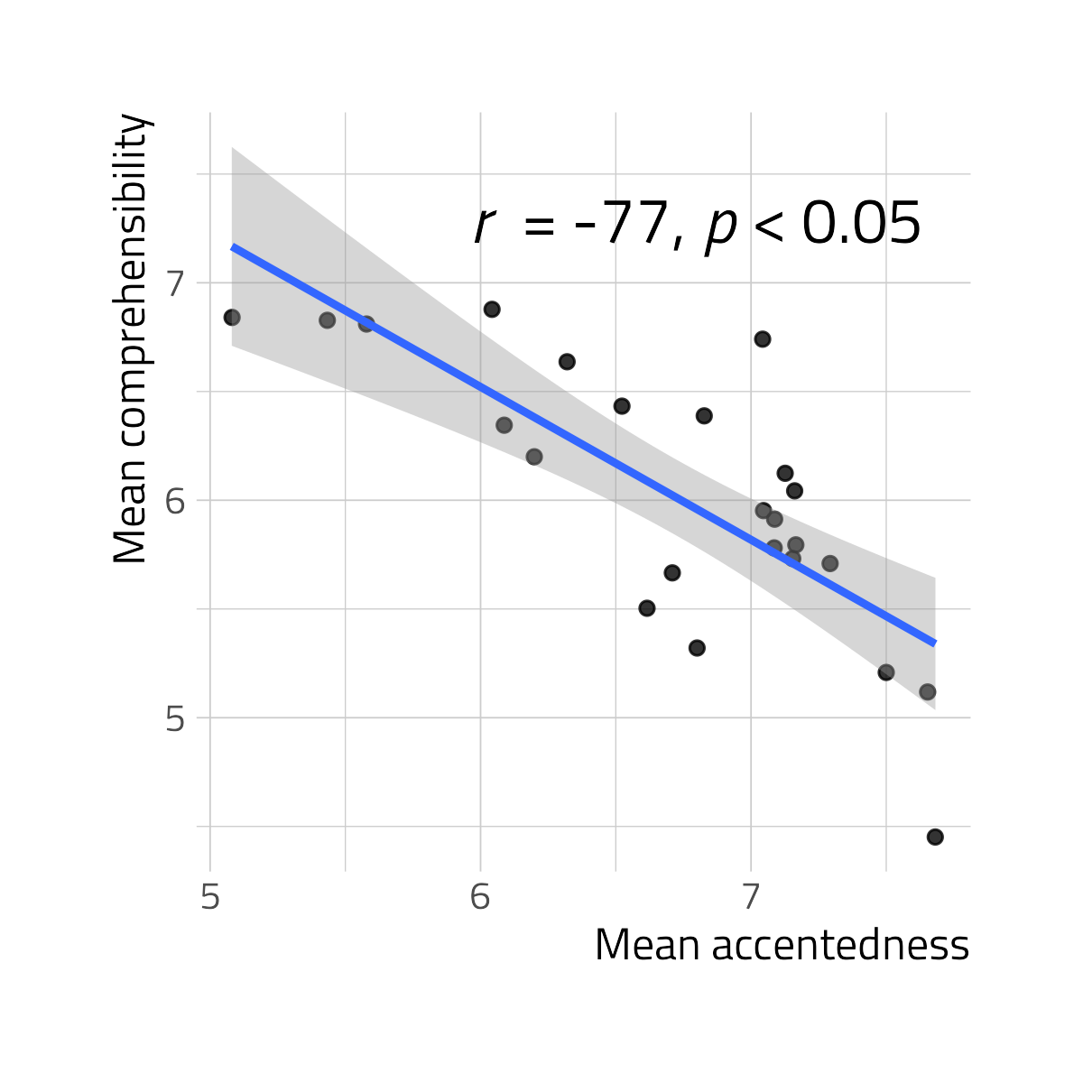
Results: Accentedness vs. comprehensibility
Significant correlation between Accentedness and Comprehensibility
The stronger the accent, the lower the comprehensibility
RQ1 – YES

Slide 12
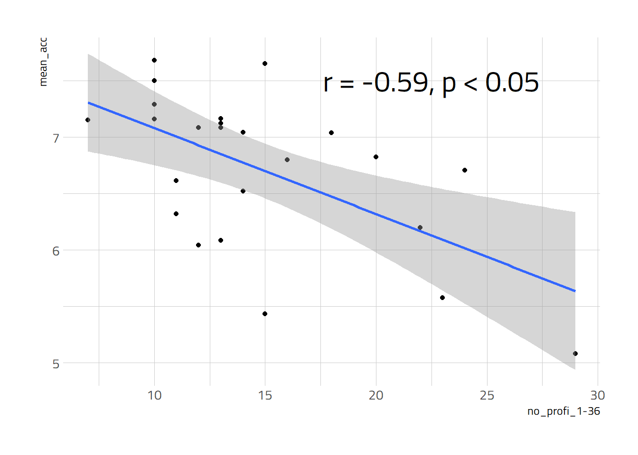
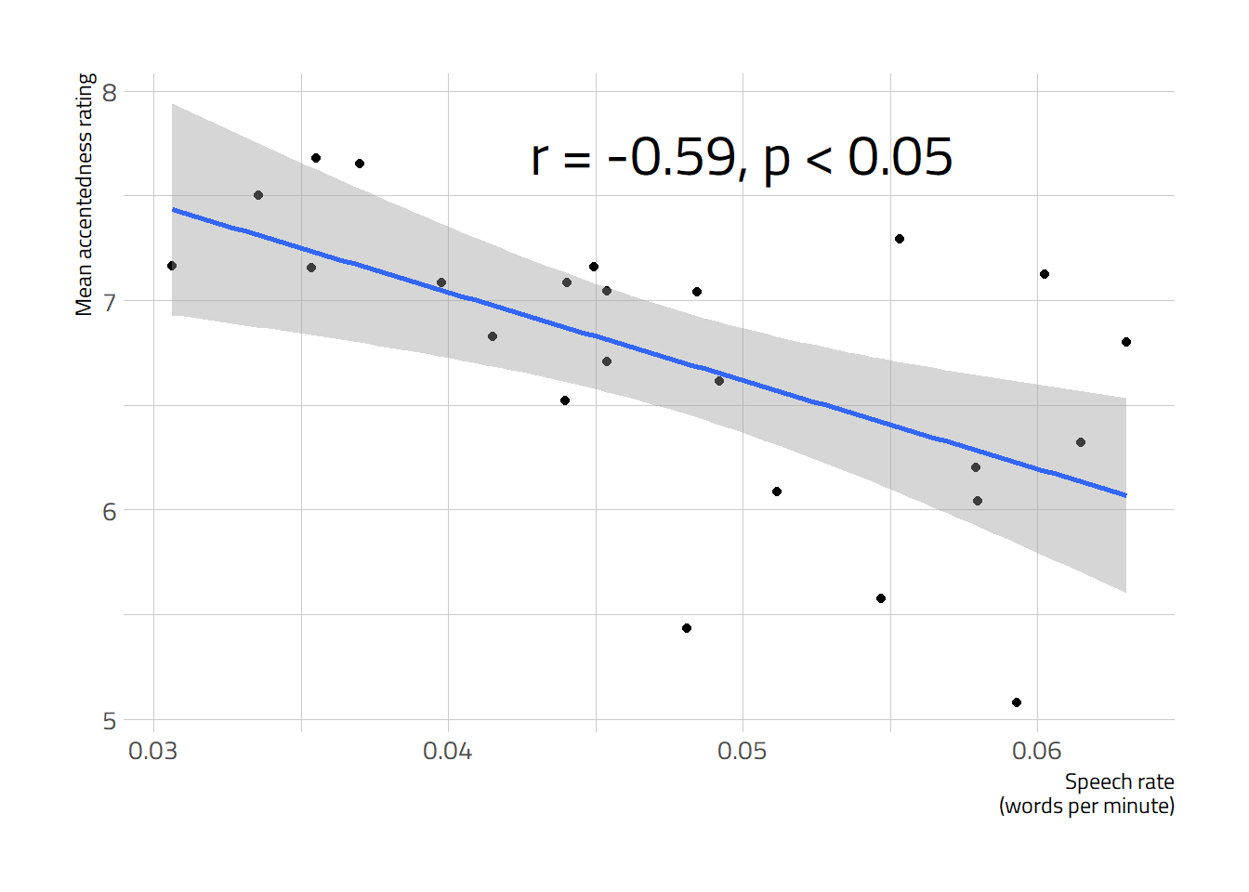
Results: Accentedness vs. factors
Accentedness and L3 Proficiency
  the higher the proficiency, the less accented
No correlation between accentedness and VOT measures
Accentedness and Oral Fluency
  the higher the speech rate, the less accented it is perceived to be
RQ 2 -> partially yes

Slide 13
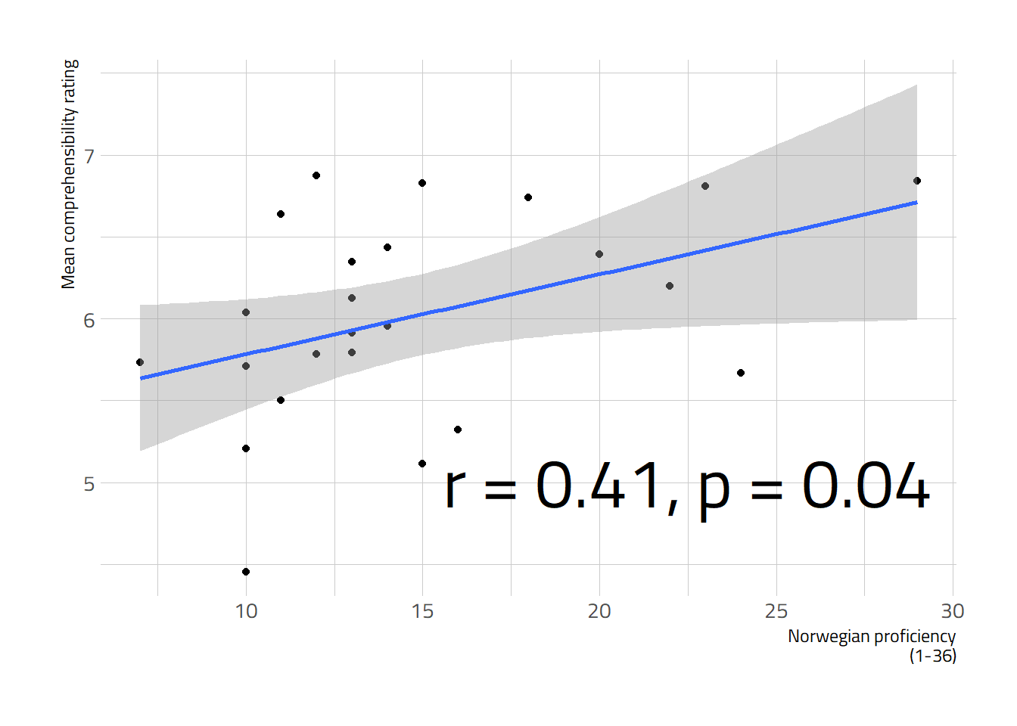
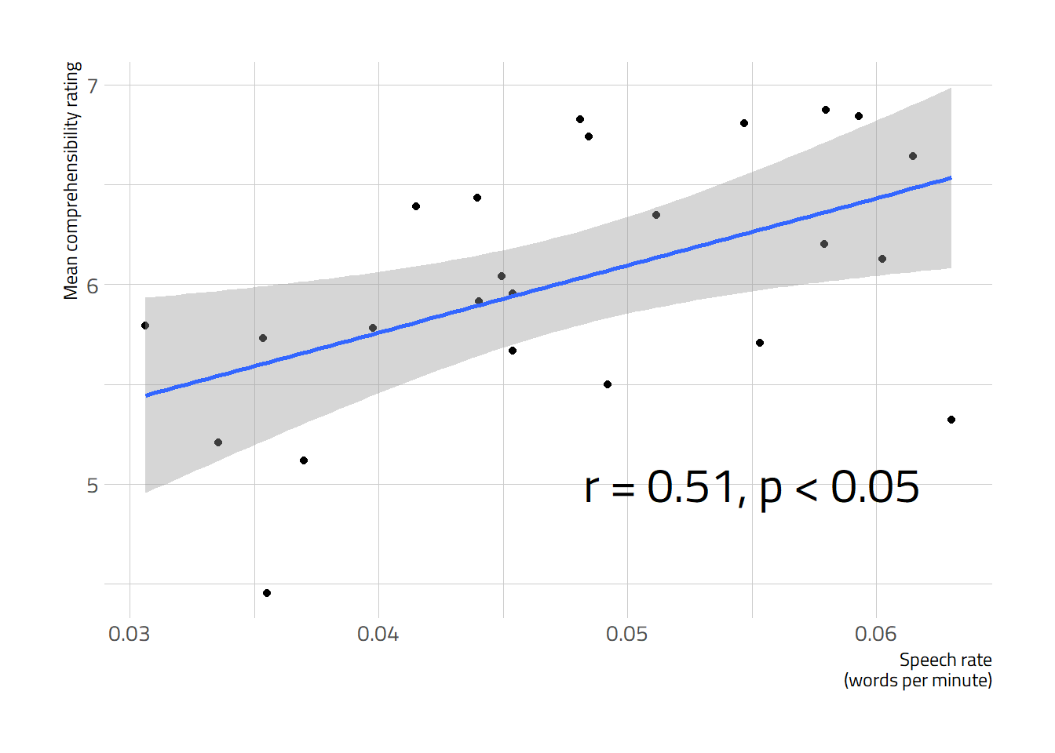
Results: Comprehensibility vs. factors
Comprehensibility and L3 Proficiency
  The higher proficiency, the better the comprehensibility
No correlation between Comprehensibility and VOT measures
Comprehensibility and Oral Fluency
  The higher the speech rate, the higher the comprehensibility rating
RQ 3 -> partially yes

Slide 14
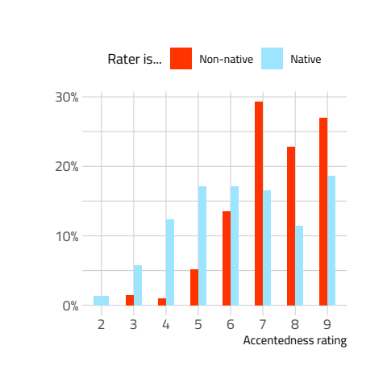
Results: rater variables
Mixed-effects ordinal logistic regression model:
  Accentedness as a function of Nativeness of Rater, with Norwegian Proficiency as control, and by-speaker and by-rater random intercepts
Significant difference between native vs. non-native raters for Accentedness but not Comprehensibility
Interrater reliability: Cronbach’s alpha for Accentedness α = 0.89; for Comprehensibility α = 0.87

Slide 15
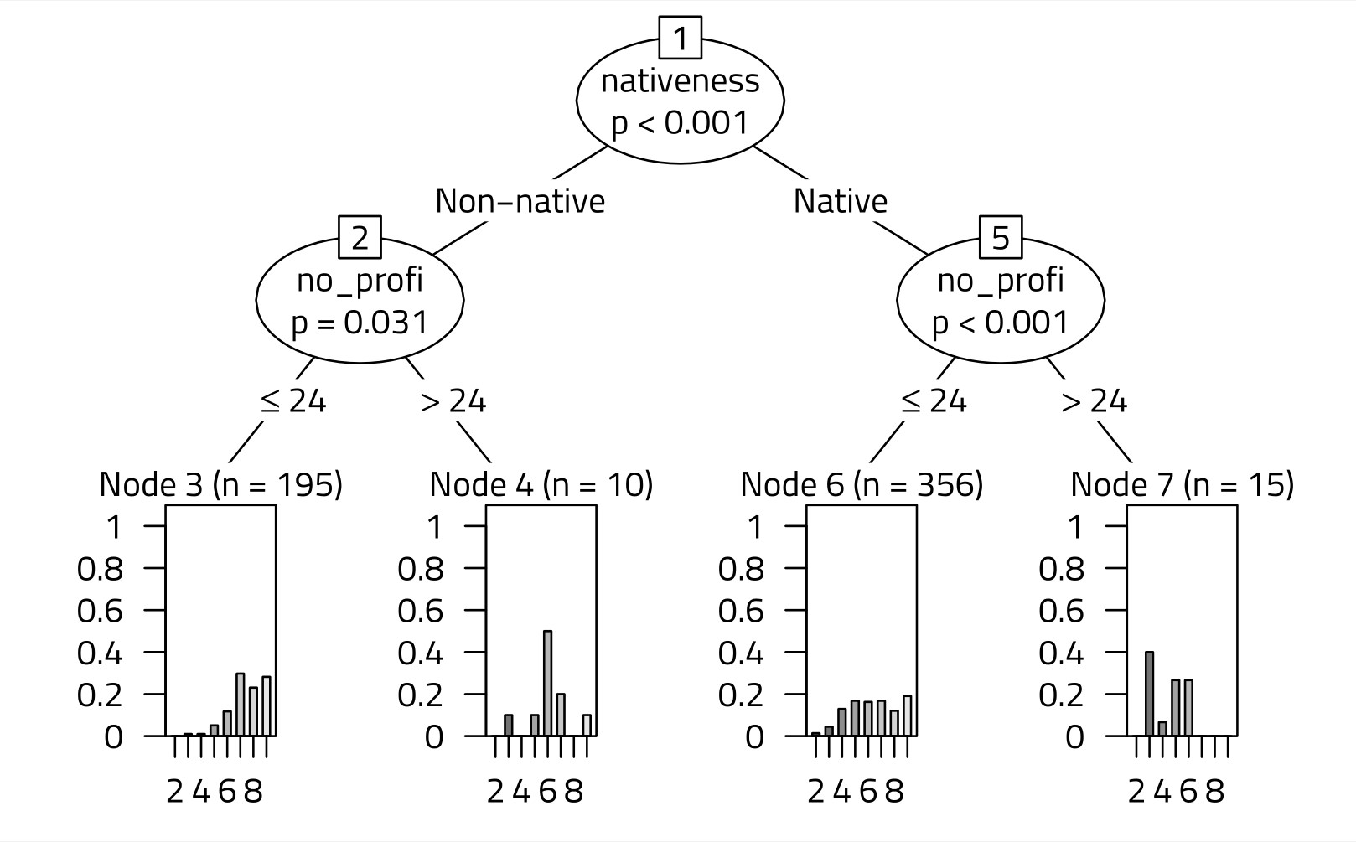
Results: importance of predictors for Accentedness
A random forest analysis

Slide 16
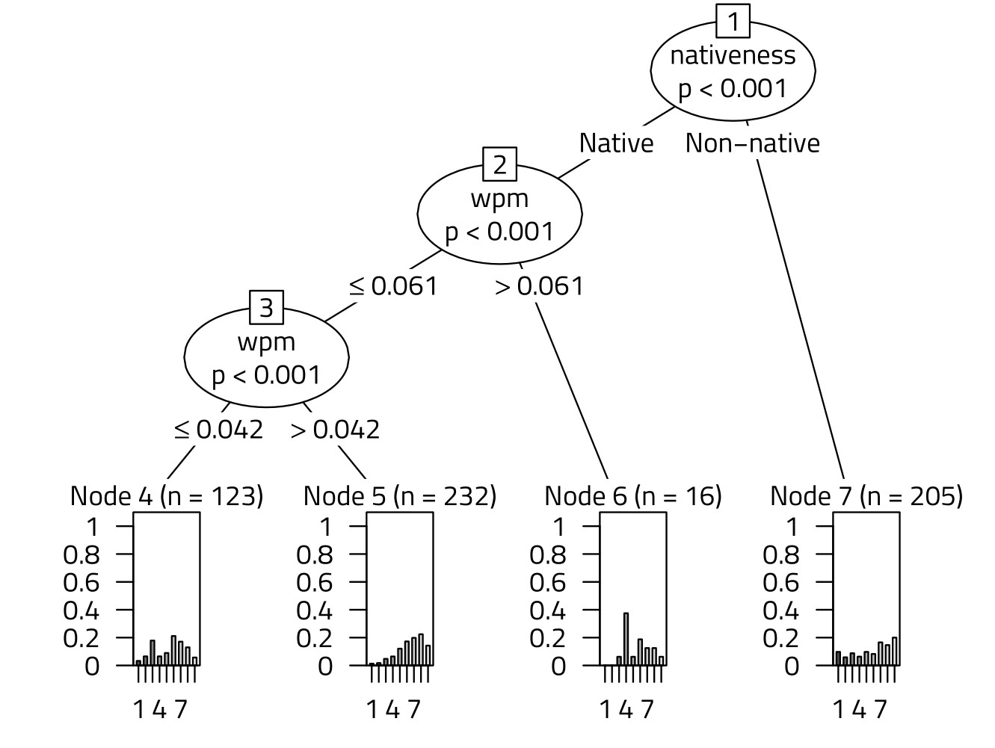
Results: predictors for Comprehensibility
Conditional importance of predictors for Comprehensibility

Slide 17
Discussion
Linguistic and extralinguistic variables in NGTA
Extralinguistic
stages of acquisition
frequency of input & use
Ln
L1
Linguistic
preferability generalizations
age of acquisition
proficiency level
metalinguistic awareness
individual factors

Slide 18
Discussion
Linguistic:
  Raters’ linguistic competence (native vs. non-native) -> the most significant predictor of ratings,
  BUT fine-grained phonetic performance (VOT in L3) was not.
Extralinguistic:
  Oral Fluency and L3 Proficiency predicted Accentedness and Comprehensibility,
  BUT the frequency of L3 use and interrater differences less important
Hierarchy of variables in the present study
  language-specific factors > oral fluency and proficiency > frequency of use and individual factors

Slide 19
Way forward
Accent ratings in L2 and L3
Formal vs. naturalistic learners
Speaking vs. reading mode

Slide 20



Acknowledgements
This research is supported by a grant of the Polish National Science Centre (NCN), OPUS-19-HS project (UMO-2020/37/B/HS2/00617), CLIMAD ”Cross-linguistic influence in multilingualism across domains: Phonology and syntax”
Norway funds/NCN grant GRIEG-1 (UMO- 2019/34/H/HS2/ 00495) ADIM “Across-domain investigations in multilingualism: ModelingL3 acquisition in diverse settings”

Slide 21
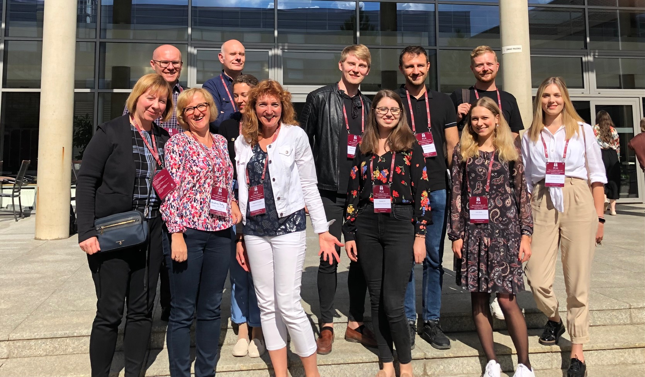

Thank you / Děkuji

Slide 22
Results
Parameters | Experimental group M (SD) | Control group M (SD)
Accentedness (1–9) | 6.72 (1.8) | 1.5 (1.5)
Comprehensibility (1–9) | 6.03 (2.3) | 7.8 (2.7)
Oral fluency (wpm) | 0.05 (0.01) | –
VOT /p/ (ms) | 44 (14) | –
VOT /t/ (ms) | 62 (15) | –
VOT /k/ (ms) | 74 (18) | –
Norwegian use (hrs/week) | 4.2 (4.6) | –

